Slide 1
Lending Club Case Study Findings
Ashish Singh Veera Muthu

Slide 2
Objective
In this case study, EDA will be carried out to understand how consumer attributes and loan attributes influence the tendency of default.
Benefits of the case study:
Applying EDA in real life business scenarios.
Key indicators to identify credit loss for the LC.

Slide 3
Business Understanding
If the applicant is not likely to repay the loan, i.e. he/she is likely to default, then approving the loan may lead to a financial loss for the company.
Data Cleansing and preparation process:
Loading Data
Dropping null value columns
Removing extra columns
Fixing null values in columns
Standardize data types and adding derived columns
Data filtration for requirement analysis.
Delete Duplicate Data
Outliers Treatment

Slide 4
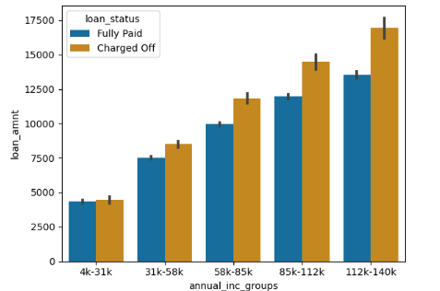
Loan Status and Amount
Loan Status: There is steady increase in default status with rising annual income.

Slide 5
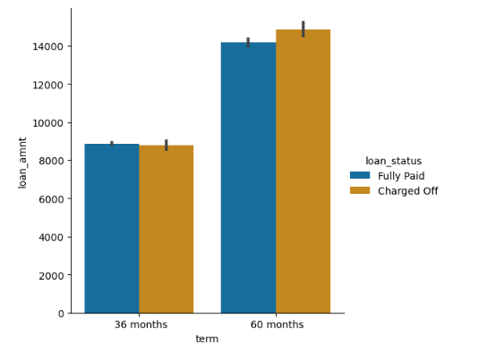
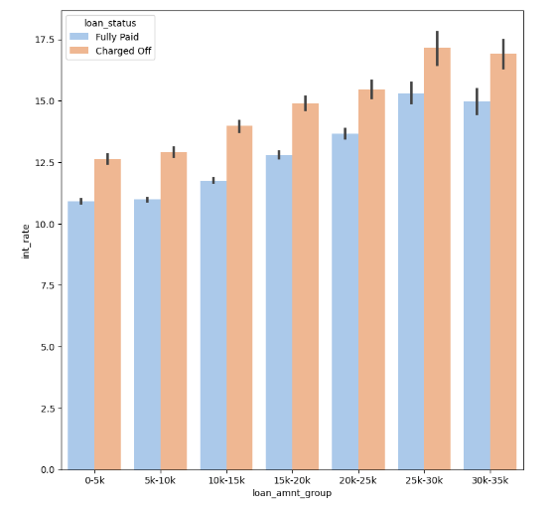
Term and Interest Rate
Loan Term vs loan_amnt: Loans taken for 60 month have higher chances of default when loan mount goes higher
Interest Rate: possibilities of defaulting increase with loan amount between 25K to 35K with rising interest rates

Slide 6
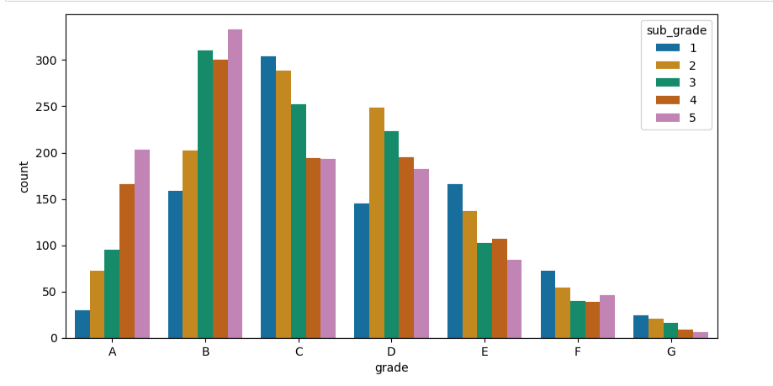
Grade and Sub-Grade
Grade: Grade B has the higher number of probabilities of defaults
Sub Grade: In Grade B, the Sub Grade has higher chances of default.

Slide 7
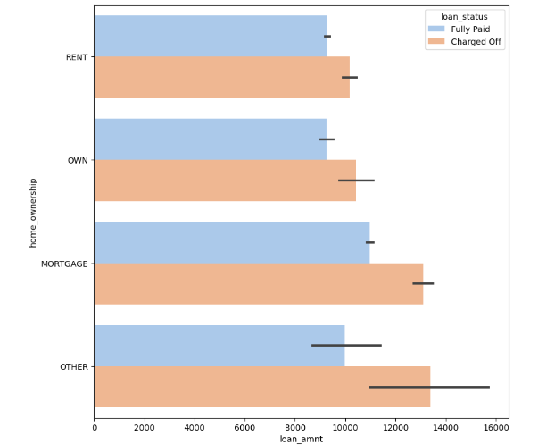
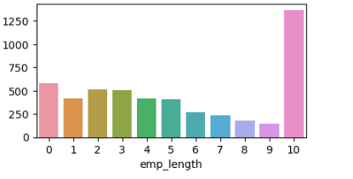
Employment Length & Home-ownership
Employment Length: Most of applicants have 10+ years of experience and have higher number of defaulted loan.
Home Ownership: With increasing loan amount applicants without own house are likely to default specially ‘mortgage’s and ‘other’

Slide 8
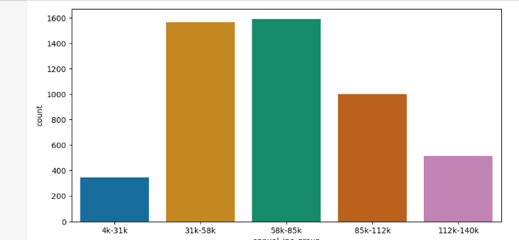
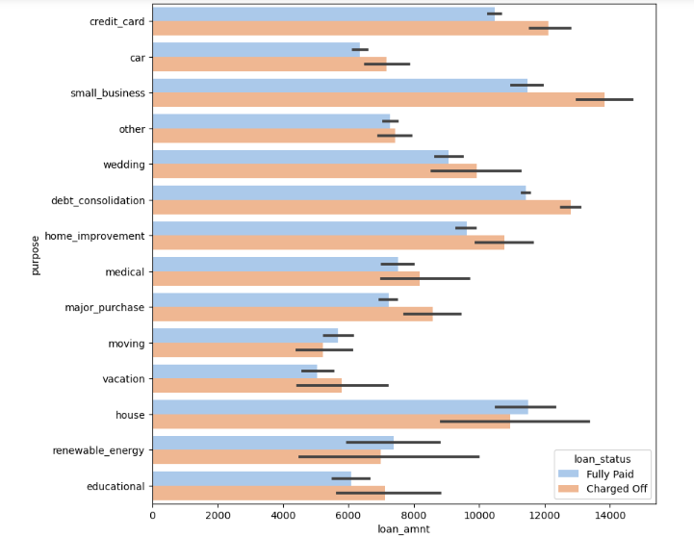
Annual Income & Purpose
Annual Income : Applicants having income range between 31k to 85K have defaulted more.
Purpose: Loans are taken mostly for debt consolidation, small business followed by credit card payment. With increased loan amount possibilities of defaults increase for purposes such as credit card, small business, debt consolidation and home improvement.

Slide 9
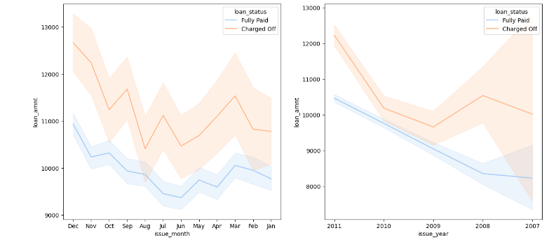
Loan Default month and year wise
Public Recorded Bankruptcy: There is rise in default between 2010 to 2011 above 10k. There is increase in defaults from mid year to year end for loan above 10k.

Slide 10
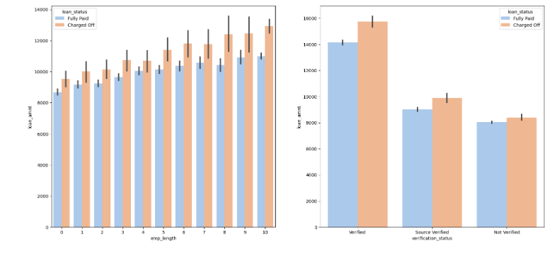
Employment length and verification status
With increase employment tenure and loan amount chances of default increases.
Non verified applicants more likely to default above loan amount 8K.

Slide 11
Recommendations
Recommendations
Major Driving factor indicating reason for default and to avoide Credit Loss:
- Applicants with income 60-70K applying loan for 'home improvement'.
- Applicants with income 60-70K applying loan for 'home improvement'.
- Applicants with income of 70-80k who got loan @ interest at the rate of 21-24%.
- Applicants with income of 30-35k who got loan @ interest at the rate of 15-17.5 %.
- Applicants loan amount is greater than 14k for purpose of small business.
- Applicants with loan amount 14-16K having home ownership as 'MORTGAGE'
- loan amount between 15-20K with grade f.
- employment length with 10yrs or more having loan amount 12k-14k
- verified loan with loan amount is above 16k
Loan grade G with interest rate 20% & above

Slide 12
Recommendations
- If applicants are having RENT and mortgage type house_ownership.
- Grade B with subgrade B5 is having most number of defaluters.
- If applicants are having purpose as debt consolidation.
- Applicants who were lended loan amount @ 13-17% interest rate.
- employement length of 10+ years
- Applicants with income range 58K- 85K
- Investor funded amount is within range5000-10000
- Loan amount is between 5429 - 10357
- Applicants with dti 12-18
- Applicants having monthly installments within range 145-274
- loans having Term of 36 months
- When income source is Not verified
- Number of enquiries in last 6 months is Zero

